Slide 1
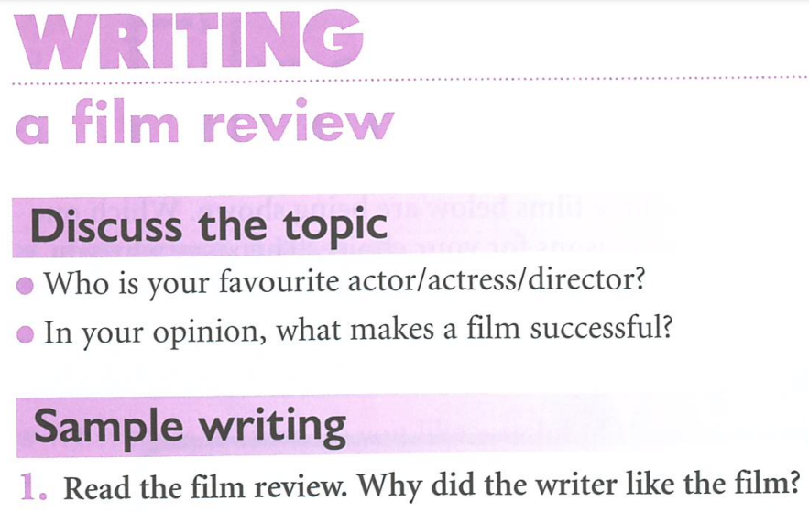

Slide 2
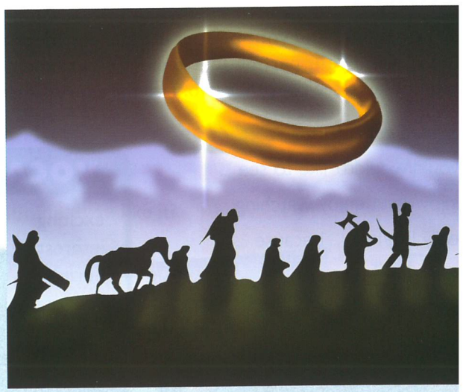

Slide 3
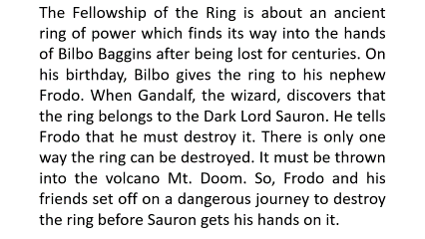
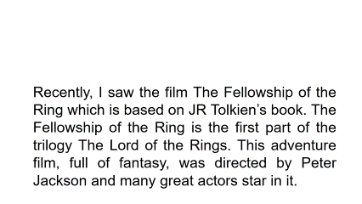
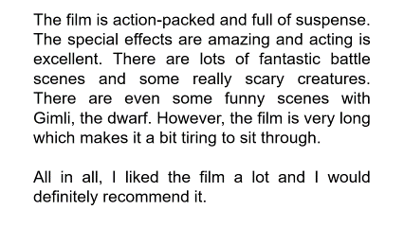

Slide 4
Recently, I saw the film The Fellowship of the Ring which is based on JR Tolkien’s book. The Fellowship of the Ring is the first part of the trilogy The Lord of the Rings. This adventure film, full of fantasy, was directed by Peter Jackson and many great actors star in it.

Slide 5
The Fellowship of the Ring is about an ancient ring of power which finds its way into the hands of Bilbo Baggins after being lost for centuries. On his birthday, Bilbo gives the ring to his nephew Frodo. When Gandalf, the wizard, discovers that the ring belongs to the Dark Lord Sauron. He tells Frodo that he must destroy it. There is only one way the ring can be destroyed. It must be thrown into the volcano Mt. Doom. So, Frodo and his friends set off on a dangerous journey to destroy the ring before Sauron gets his hands on it.

Slide 6
The film is action-packed and full of suspense. The special effects are amazing and acting is excellent. There are lots of fantastic battle scenes and some really scary creatures. There are even some funny scenes with Gimli, the dwarf. However, the film is very long which makes it a bit tiring to sit through.
All in all, I liked the film a lot and I would definitely recommend it.

Slide 7

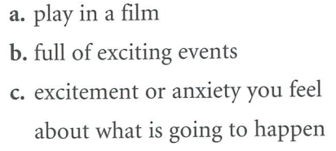
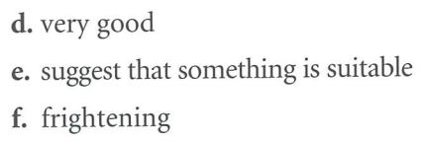
Star.
Action-packed.
Suspense.
Fantastic.
Recommend.
Scary.

Slide 8
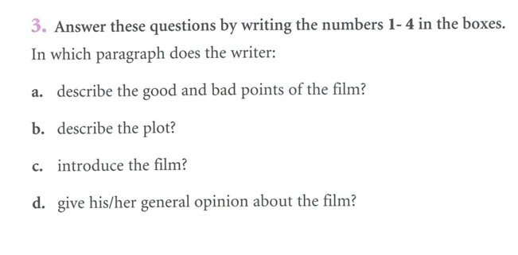
3
2
1
4

Slide 9
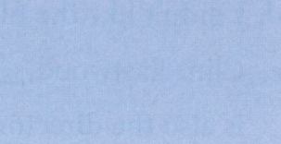
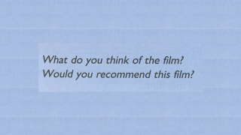
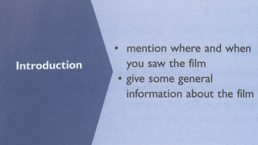
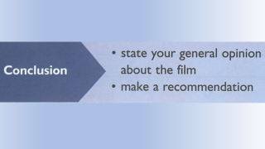
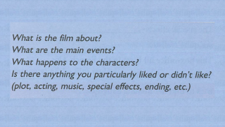
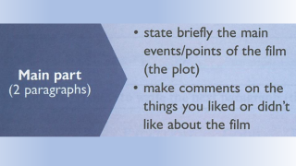
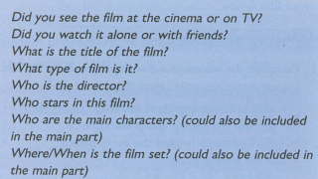
Guide to planning
Below is a general outline of a plan for a film review with questions to guide you. Your actual plan will need content and sequence and will need to answer these questions.

Slide 10
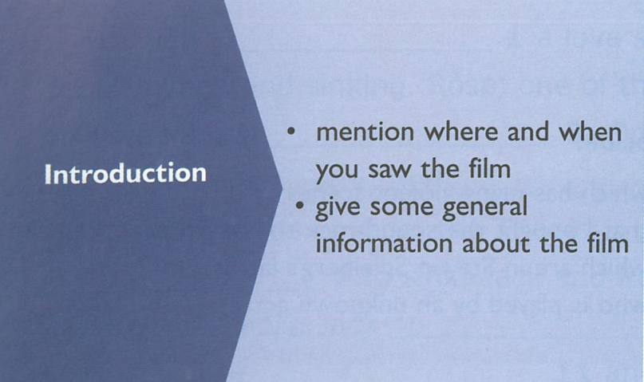

Slide 11
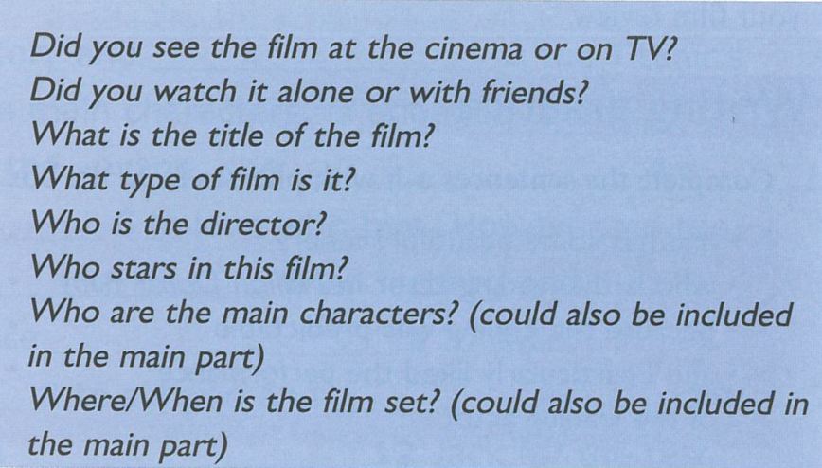

Slide 12
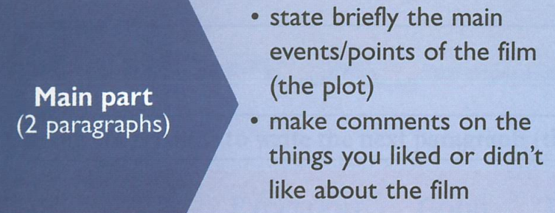

Slide 13
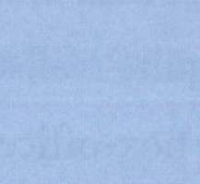
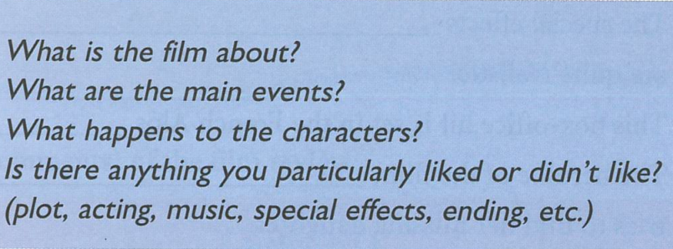

Slide 14
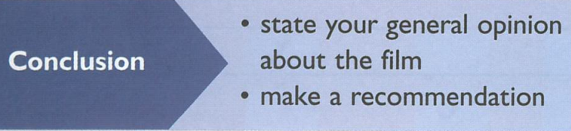

Slide 15
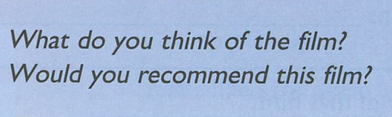

Slide 16
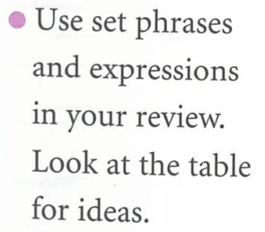
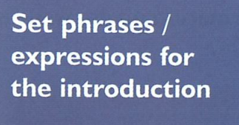
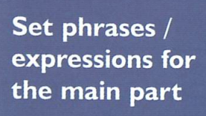
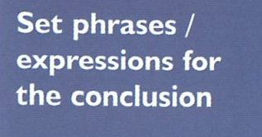
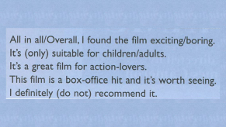
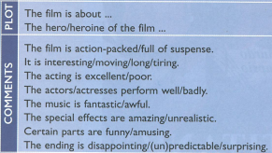
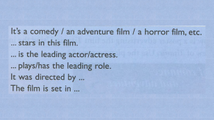
•
Use the Present Simple when writing a film review. Note that when you are expressing your opinion about the film, you can also use the Past Simple.
•
Use relative clauses introduced by relative pronouns (who, which, etc.) and adverbs (where, when) for time.

Slide 17
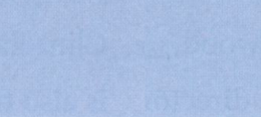
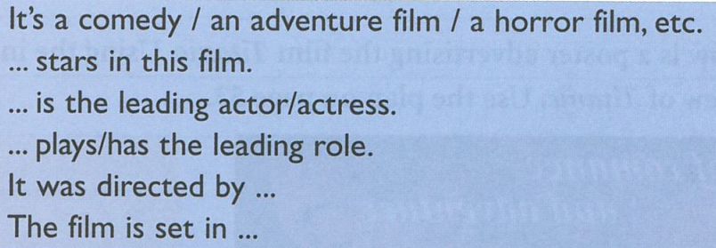

Slide 18


Slide 19
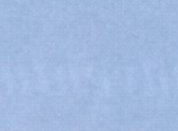
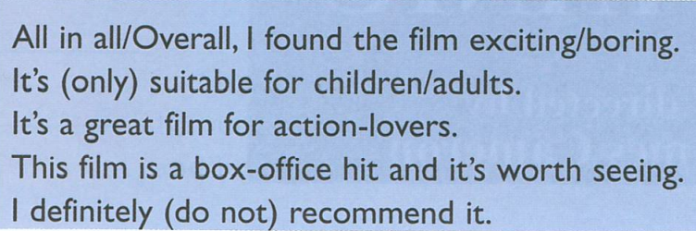

Slide 20
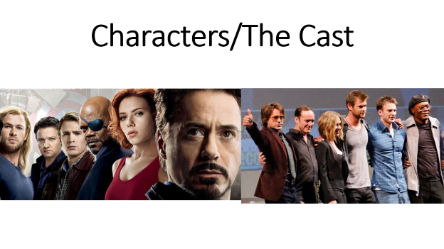
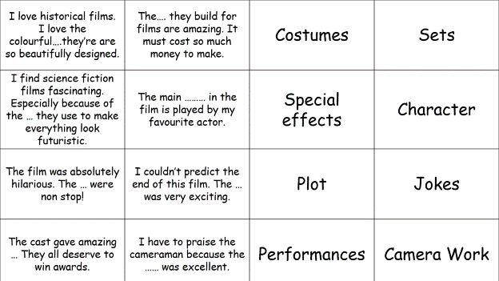

Slide 21
Writing practice 1. Complete the sentences a-h with phrases from the box below.
• which has many violent scenes • and has some beautiful scenery • who is the leading actor in Million Dollar Baby
• that I bought the soundtrack the next day • because the ending was predictable • and I particularly liked the performance of the leading actor • which are in Steven Spielberg's latest film • who is played by an unknown actress

Slide 22
The special effects, _______________________________
__________ are quite realistic. b. This box-office hit is set in the French Alps _____________ _______________ .
c. The heroine of the film, ___________________________
________ tries to find her missing daughter. d. I didn't like the film __________________________________
e. Clint Eastwood, _____________________________________
_____ is also the director of that film. f. I loved the music of the film so much _________________
_________________________ g. It's an action-packed film _____________________________ so
it's not suitable for children. h. The acting was excellent __________________________
_______________________________

Slide 23
I love historical films. I love the colourful….they’re are so beautifully designed. | The…. they build for films are amazing. It must cost so much money to make. | Costumes | Sets
I find science fiction films fascinating. Especially because of the … they use to make everything look futuristic. | The main ……… in the film is played by my favourite actor. | Special effects | Character
The film was absolutely hilarious. The … were non stop! | I couldn’t predict the end of this film. The … was very exciting. | Plot | Jokes
The cast gave amazing … They all deserve to win awards. | I have to praise the cameraman because the …… was excellent. | Performances | Camera Work

Slide 24
The special effects, _______________________________
__________ are quite realistic. b. This box-office hit is set in the French Alps _____________ _______________ .
c. The heroine of the film, ___________________________
________ tries to find her missing daughter. d. I didn't like the film __________________________________
e. Clint Eastwood, _____________________________________
_____ is also the director of that film. f. I loved the music of the film so much _________________
_________________________ g. It's an action-packed film _____________________________ so
it's not suitable for children. h. The acting was excellent __________________________
_______________________________
which are in Steven Spielberg's
latest film,
and has some
beautiful scenery
who is played by an unknown
actress
because the ending was predictable.
who is the leading actor in Million Dollar
Baby
that I bought the
soundtrack the next day.
which has many violent scenes,
and I particularly liked the
performance of the leading actor.
Back
Next

Slide 25
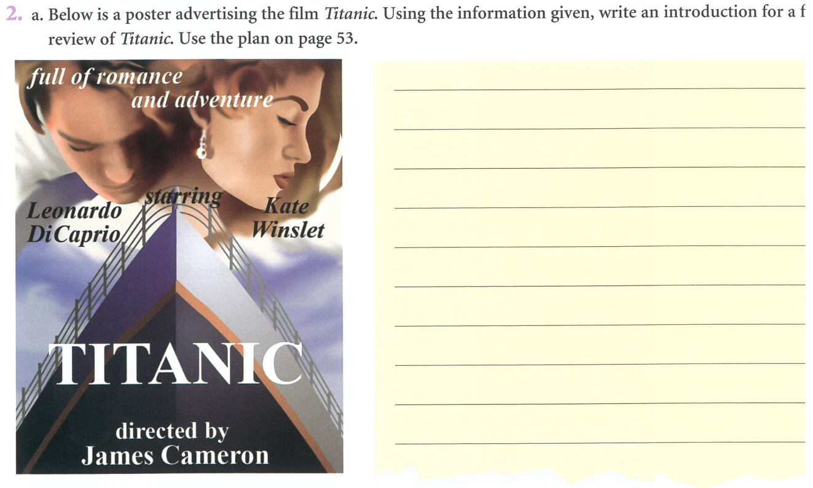
When I first watched Titanic as a teenager in my parents’ house, I didn’t expect it to affect me so much. Even though I already knew how the story would end, I quickly became interested in the lives of the people on the ship. The film made me imagine what it might have felt like to be there, surrounded by excitement, hope, and danger. It was a powerful experience that stayed with me after the film finished.

Slide 26
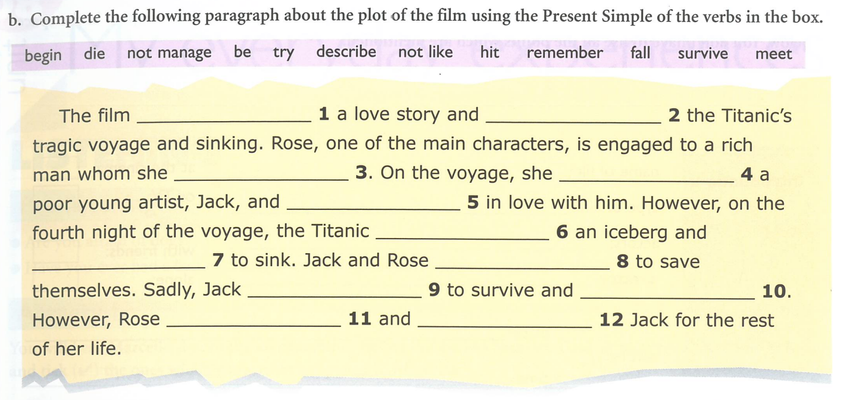
is
describes
doesn’t like
meets
falls
hits
begins
try
doesn’t manage
dies
survives
remembers
Second paragraph of your homework.

Slide 27
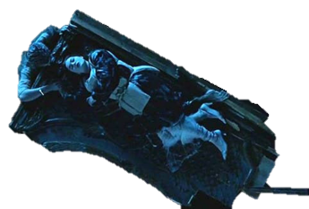
Some people say, there’s room for two on that door

Slide 28
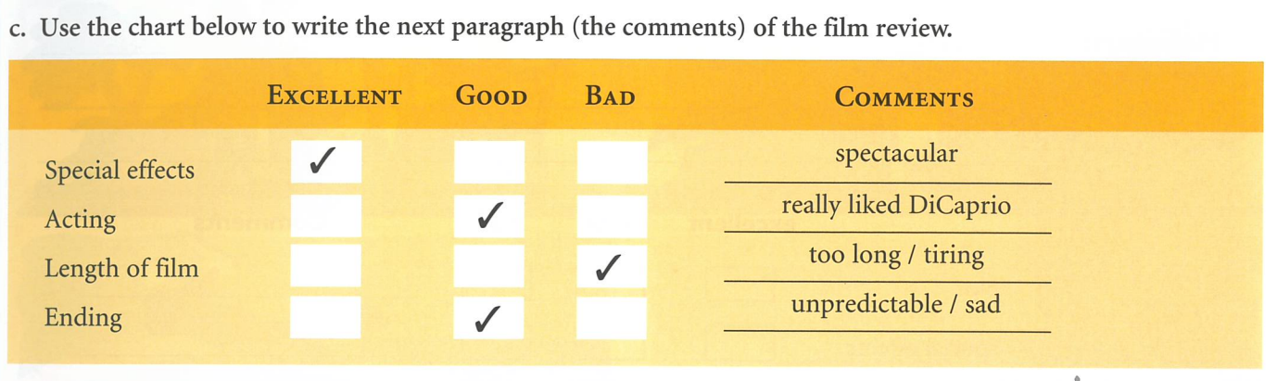
Third paragraph of a review of Titanic.

Slide 29
Glossary
Trilogy a work in three parts. E.g. Star Wars I, II and III.
Wizard a person with special magical powers. Someone who can supposedly do real magic.
Fellowship friendly association, especially with people who share one's interests.
Mt Abbreviation of Mount, which is often used in the names of mountains.
E.g. Mt Everest = Mount Everest.
Dwarf A short person.
Where is the film set = The place where we are meant to think the film is showing. A film can be set in France but filmed in the UK. Obviously, films set on another planet are filmed on Earth.
Set [There are more different definitions of the word set than any other word.]
Plot = The story.
Supporting actor/actress = Not the leading ones.
Hero A heroic man, a brave man or one who does great things.
Heroine A heroic woman, a brave woman or one who does great things.
Heroin An opiate drug.

Slide 30
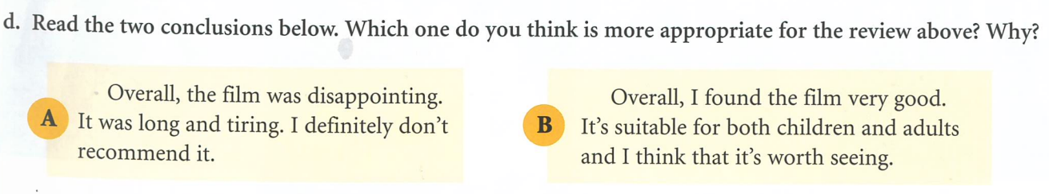
The rest of the review was really positive , so this is not in keeping with what the writer has already written. It’s a bit self-centred. It doesn’t say who might want to see it.
This is in keeping with the generally positive review and also mentions who would like it.

Slide 31
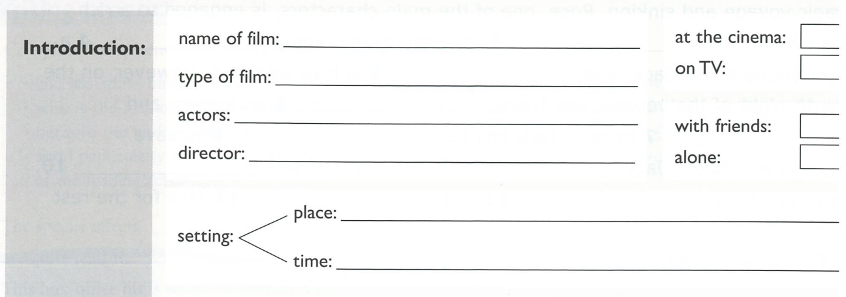

Slide 32
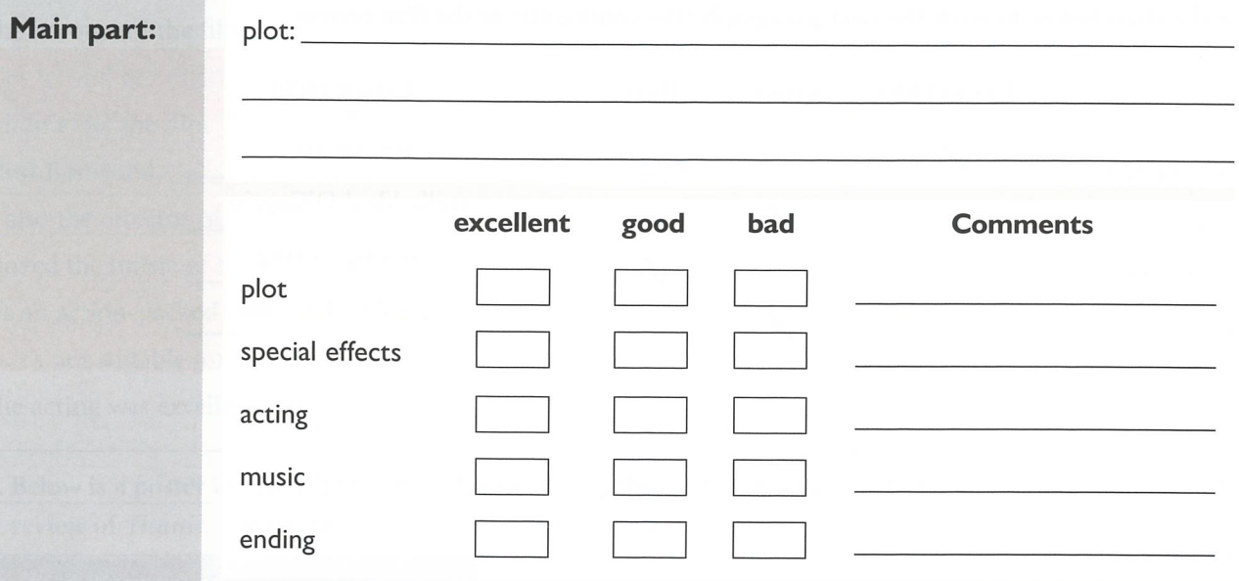

Slide 33
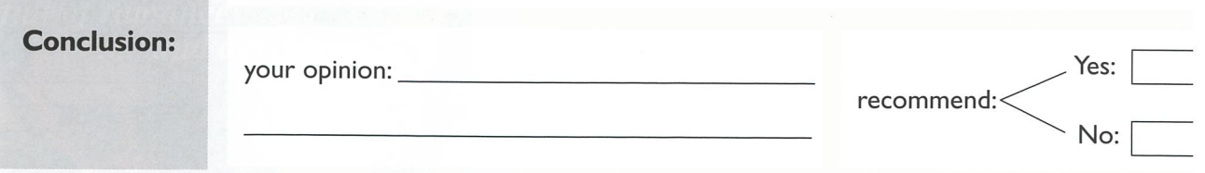

Slide 34
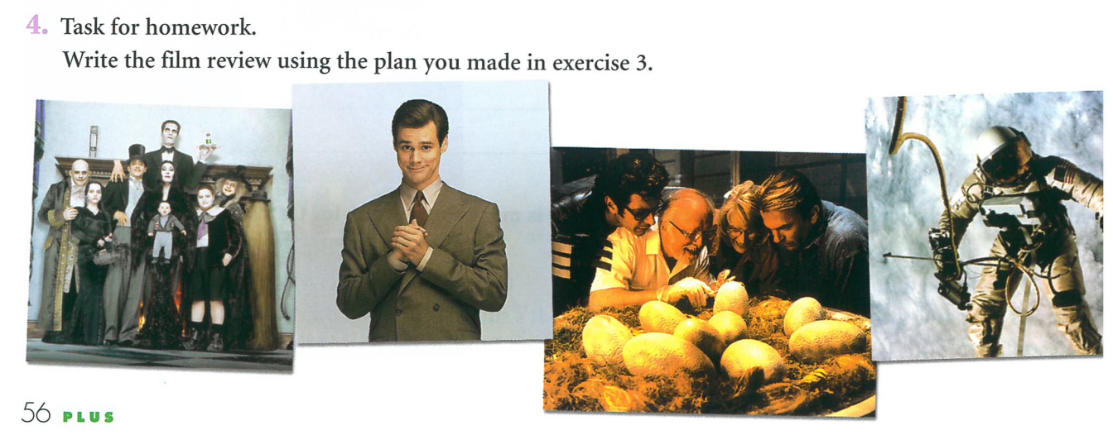
Maybe next week.

Slide 35
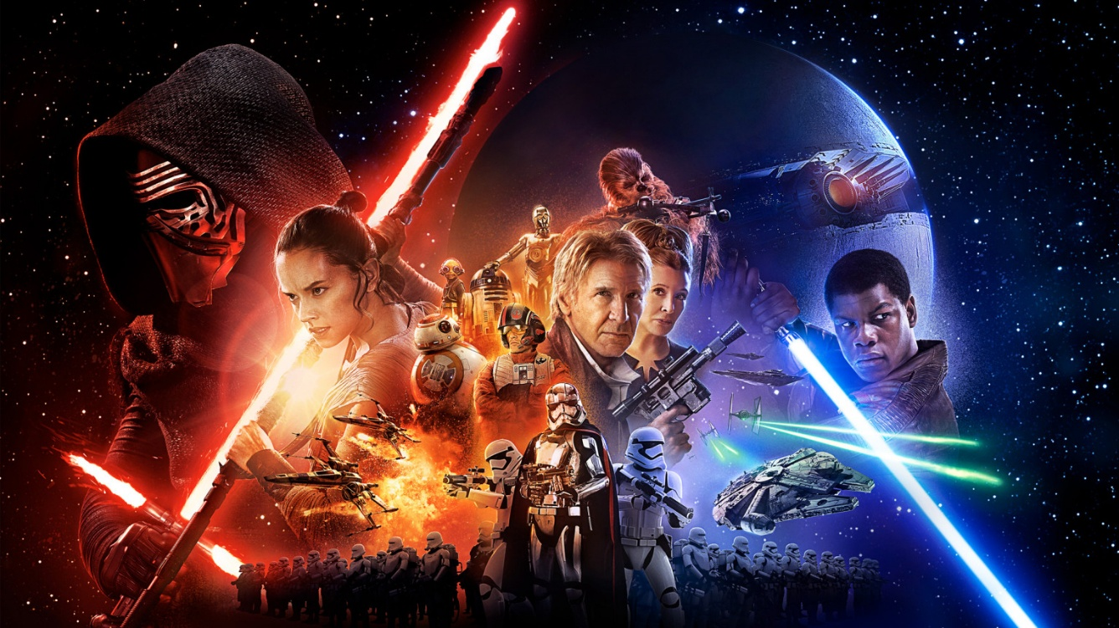
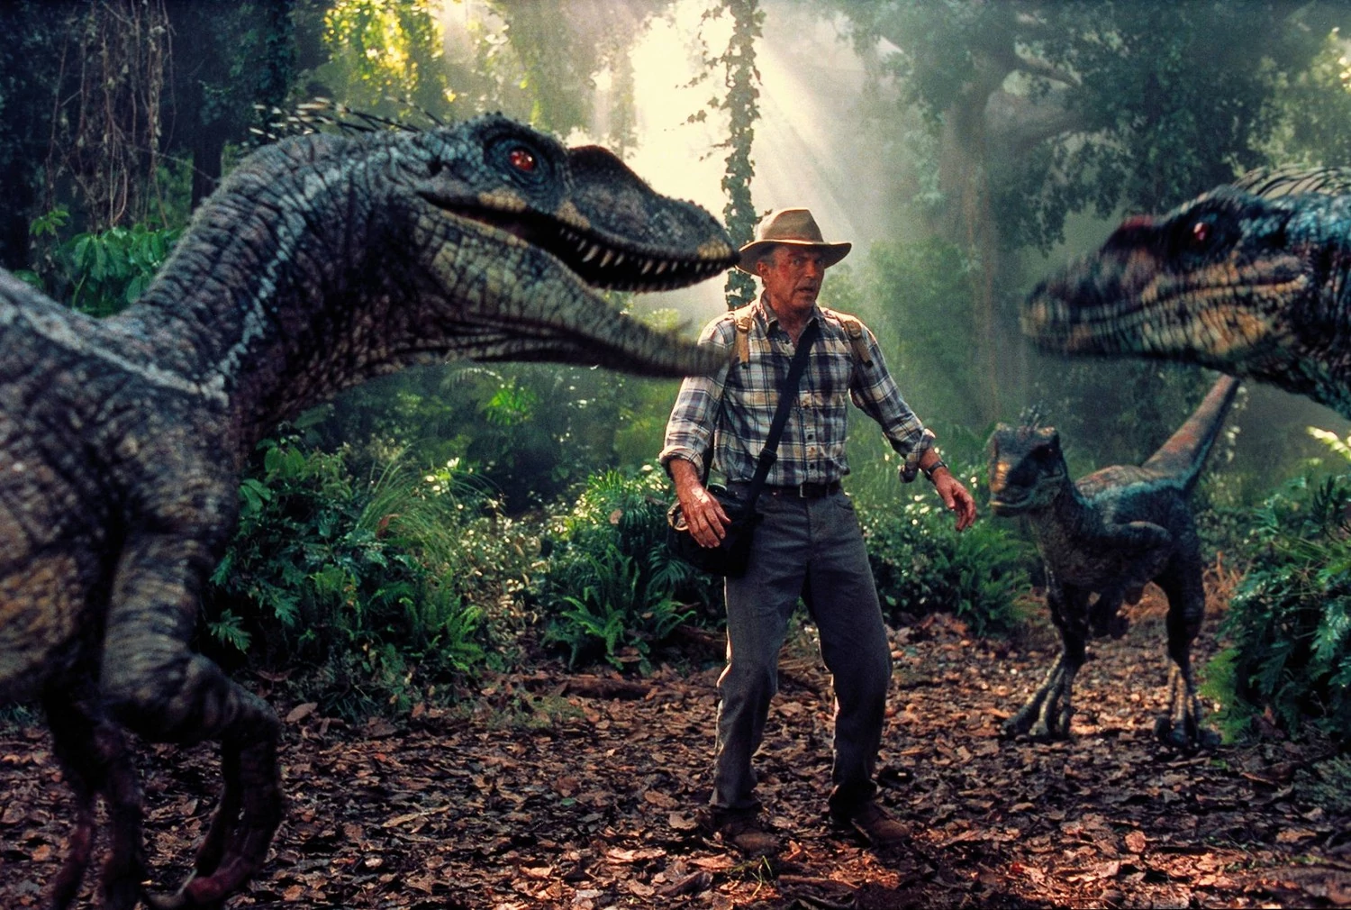
Read the article about special effects in films and complete the missing words with the best word in the correct form (noun, verb, adjective, adverb)

Slide 36
Today
Talk about a TV show or film that you like and describe why you like them using phrases for giving opinions and specialist vocabulary on the topic. Use persuasive language to convince others to watch it.
Level 1 Writing Exam Task 3: (could be) A Review of a film, TV show or book.

Slide 37
Complete the sentences with 1 of the different types of film.
My favourite type of entertainment is ……………….……….
I am keen on ……………………………..
I am not interested in ……………………………..
I don’t mind………………………………..
I would recommend watching …………………………………
I can’t stand ……………………………….

Slide 38
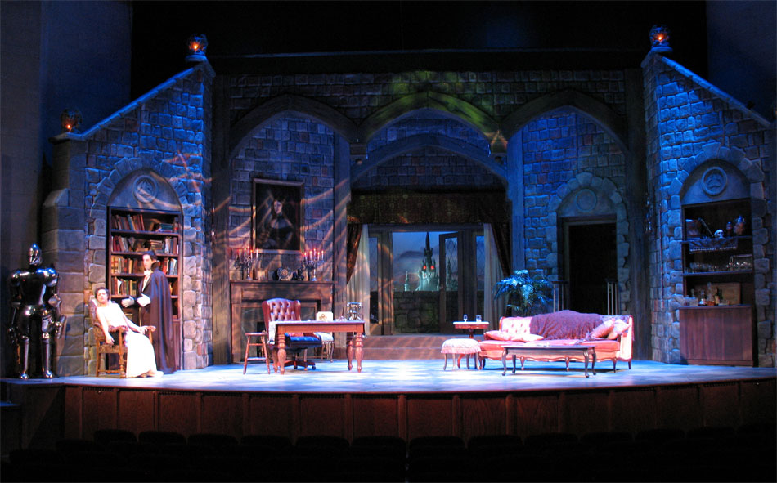
Scenery/The Set

Slide 39
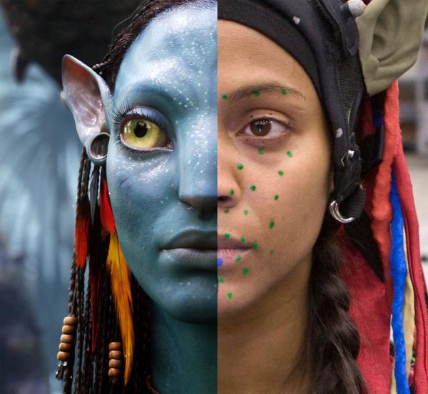
Special Effects

Slide 40
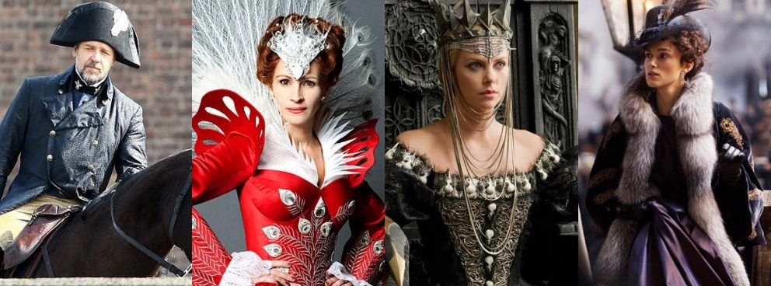
Costumes

Slide 41
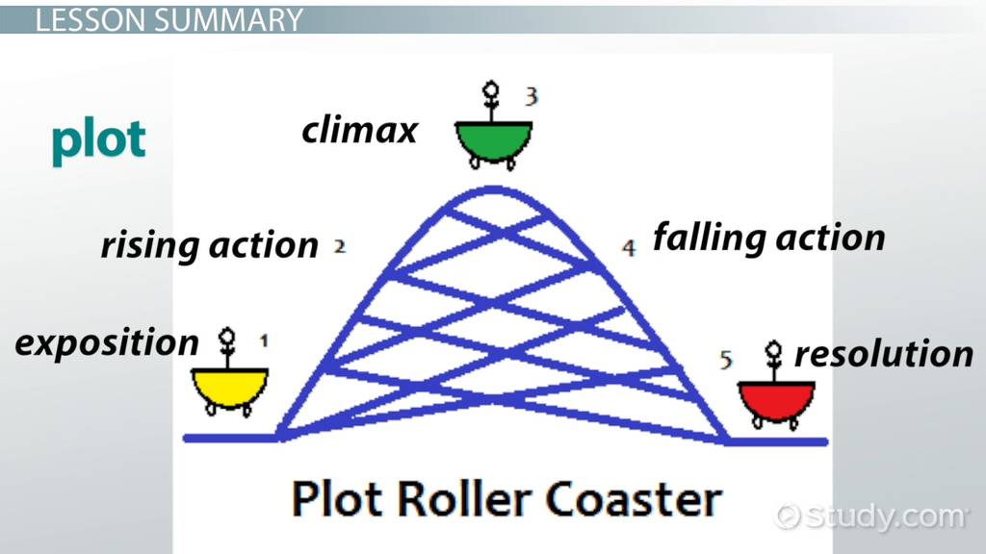
The Plot

Slide 42


Characters/The Cast

Slide 43

Camerawork

Slide 44

Performance

Slide 45

Answer the questions as quickly as possible
Why did she decide to read the book?
Before she saw the film, what did she expect?
What 3 things did she like about the film?
What do you think the phrase means ‘it did the book justice’ means?
Notes:
From Cutting Edge Unit 7

Slide 46

Answer the questions as quickly as possible
Why did she see this show?
What word does she use to say that she liked it?
What things did she like about it?
Who was her favourite character?
What word does she use to describe the stage design?
Notes:
From Cutting Edge Unit 7

